Slide 1
The Effects of Redlining on the Black Community of Portland
DJ Wooley

Slide 2
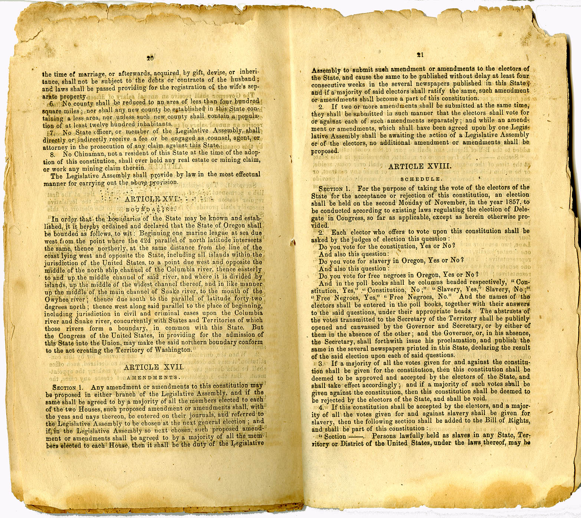
The First Exclusionary Laws
Many of the settlers that came to Oregon were intrigued by the opportunity to not have to compete with farmers in the south who owned slaves. To keep slave holding farmers away, the small population residing in Oregon decided to ban slavery on July 5, 1843.
Section of Oregon’s Constitution outlining slavery laws. Photo provided by the Oregon Historical Society

Slide 3
On November 7, 1857 delegates of the Oregon Constitution added another exclusionary clause that banned Black people in the state from owning property and creating contracts.
On September 21, 1849 the growing anti-slavery and anti-Black population in Oregon voted on adding the second exclusionary law into the Oregon Territorial Constitution. This law prohibited all Black or mixed raced individuals from moving into or even entering the territory.
In 1854 the second exclusionary law is rescinded

Slide 4
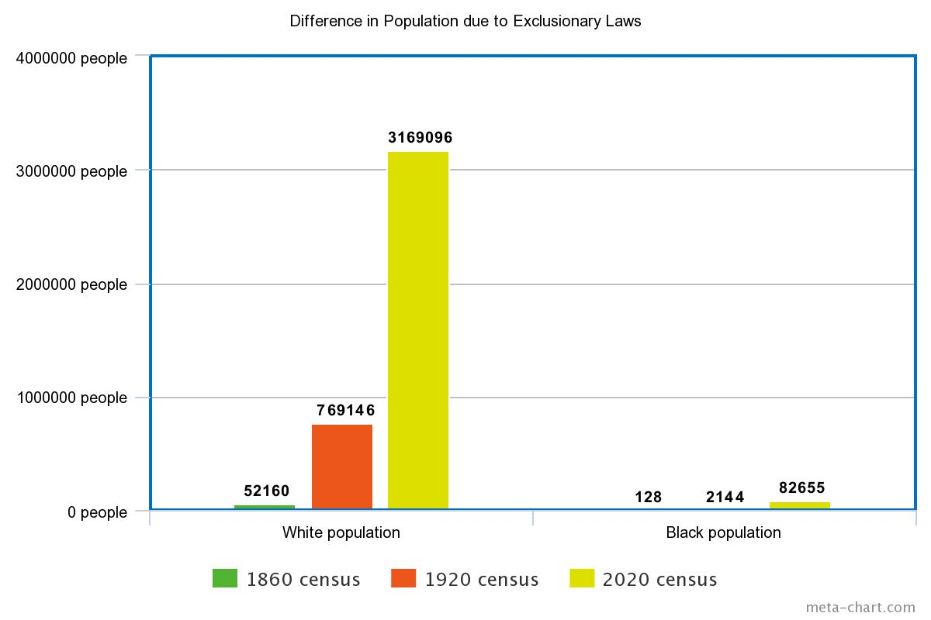

Slide 5
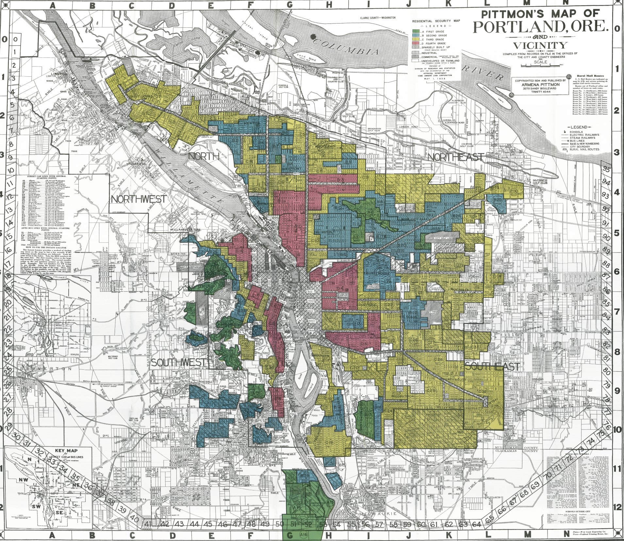
Redlining begins
1917
US Supreme Court bans cities from segregating neighborhoods based on race
1920
Developers and renters began practicing racially restricted covenants
1930s
Lenders and the Fed government began zoning neighborhoods based on desirability
1919
Portland Realty Board declared selling a home in a white neighborhood to a Black person unethical

Slide 6
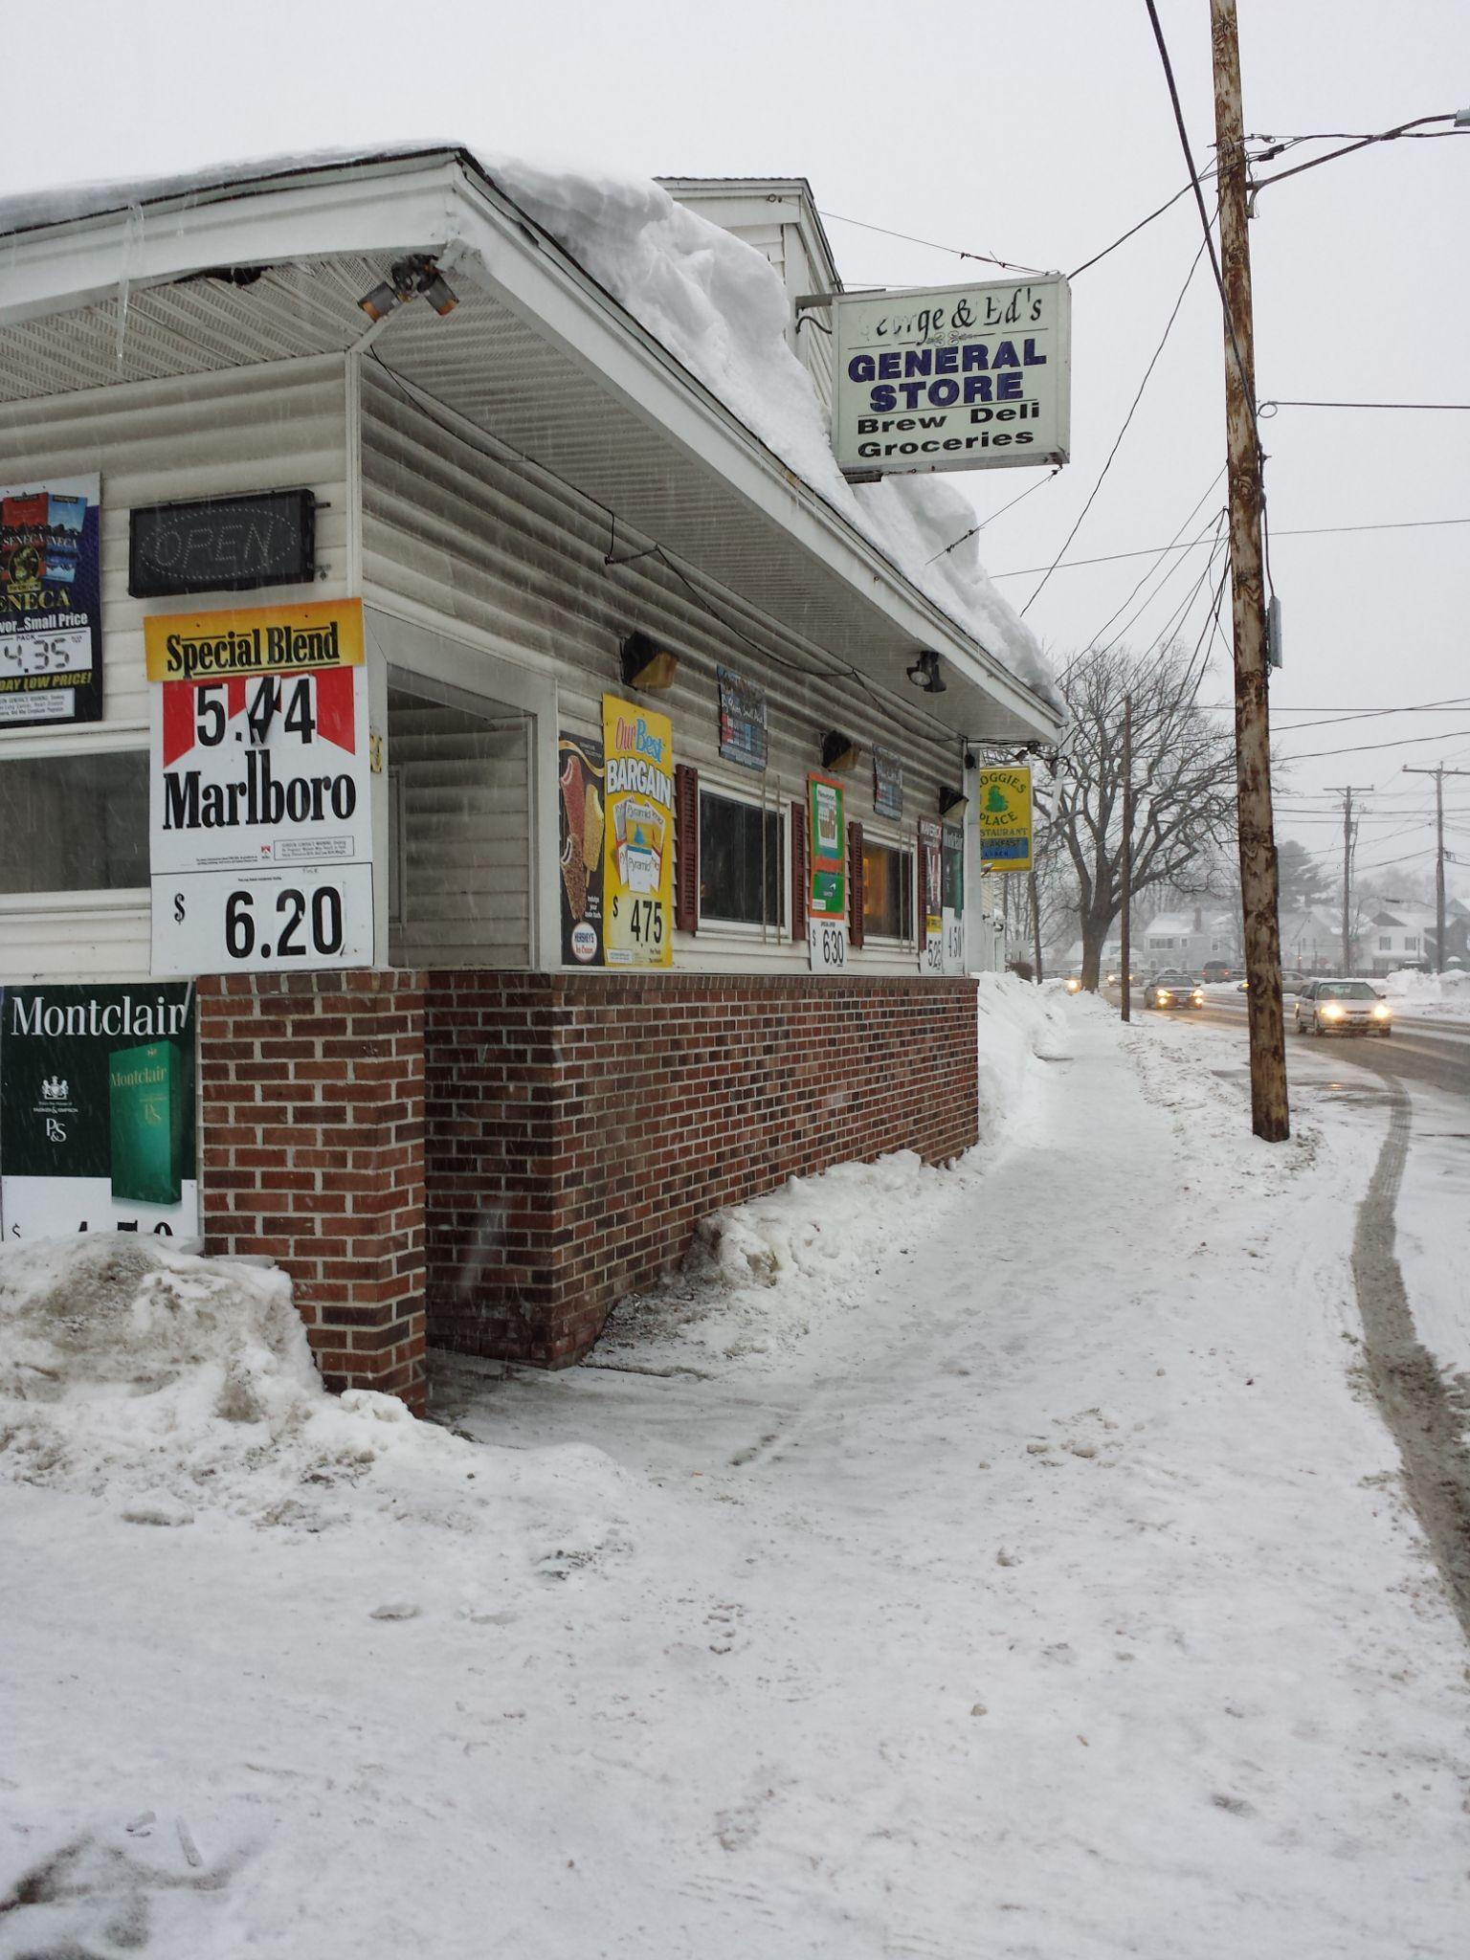
Food Deserts
A food desert is when there is a community of people that live in an area that does not have access to healthy and affordable food. This inequality is directly linked to disparities in diet and diet related health issues.
"Into the (Food) Desert: Day 20" by Mark Bonica is licensed under CC BY 2.0.

Slide 7
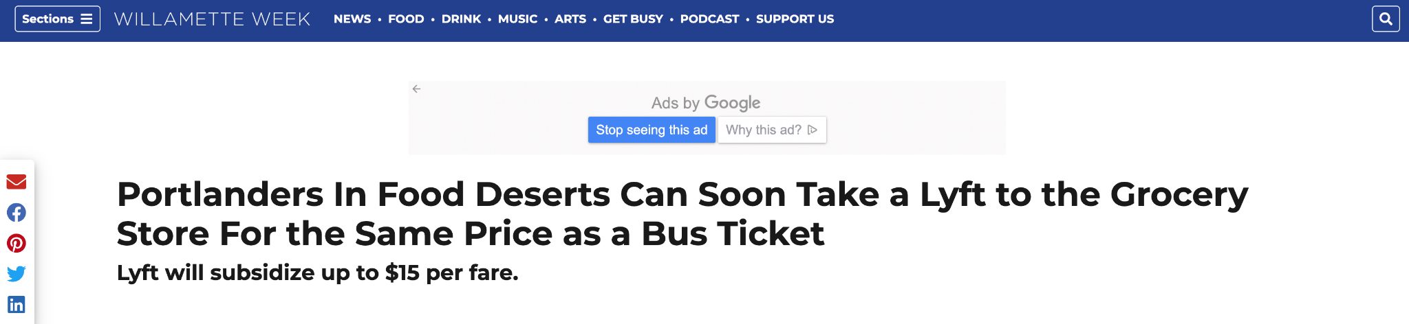
In 2019 the Willamete Week published an article promoting a Lyft deal that would charge residents in food deserts the same price as a bus ticket. The Powellhurst-Gilbert neighborhood in South East Portland is one out of six communities listed as being in a food desert.

Slide 8
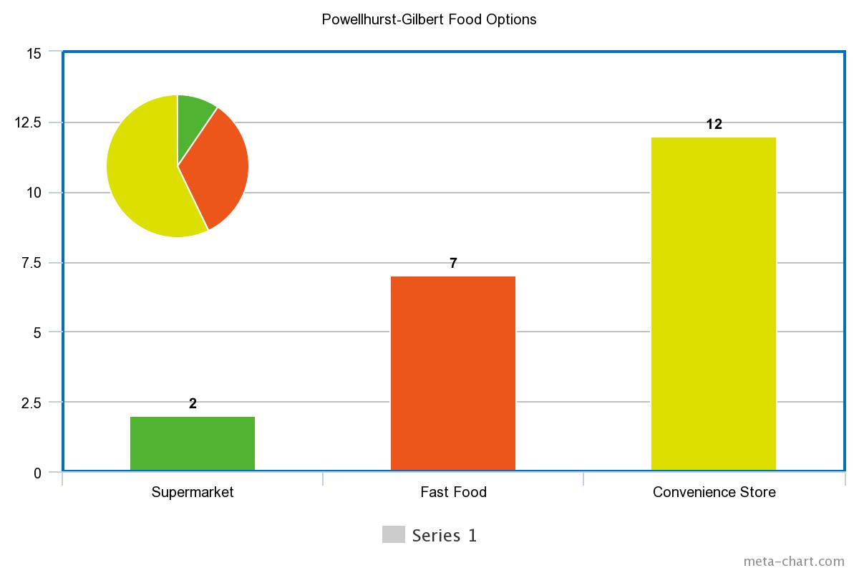
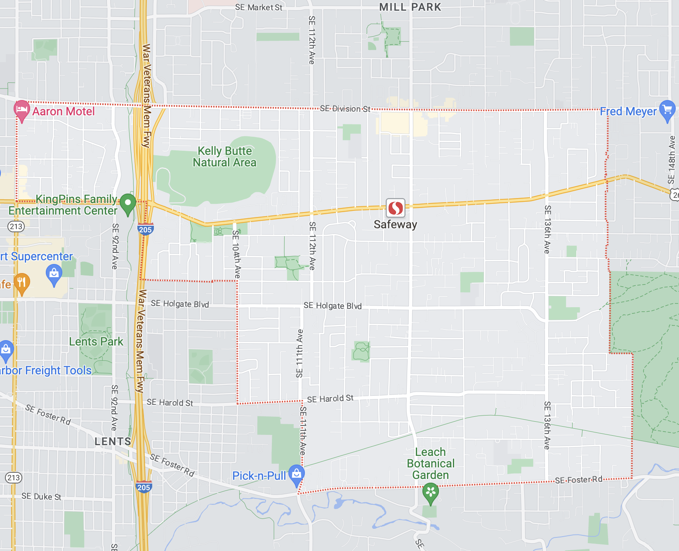
2 grocery stores: Safeway and Grocery Outlet

Slide 9
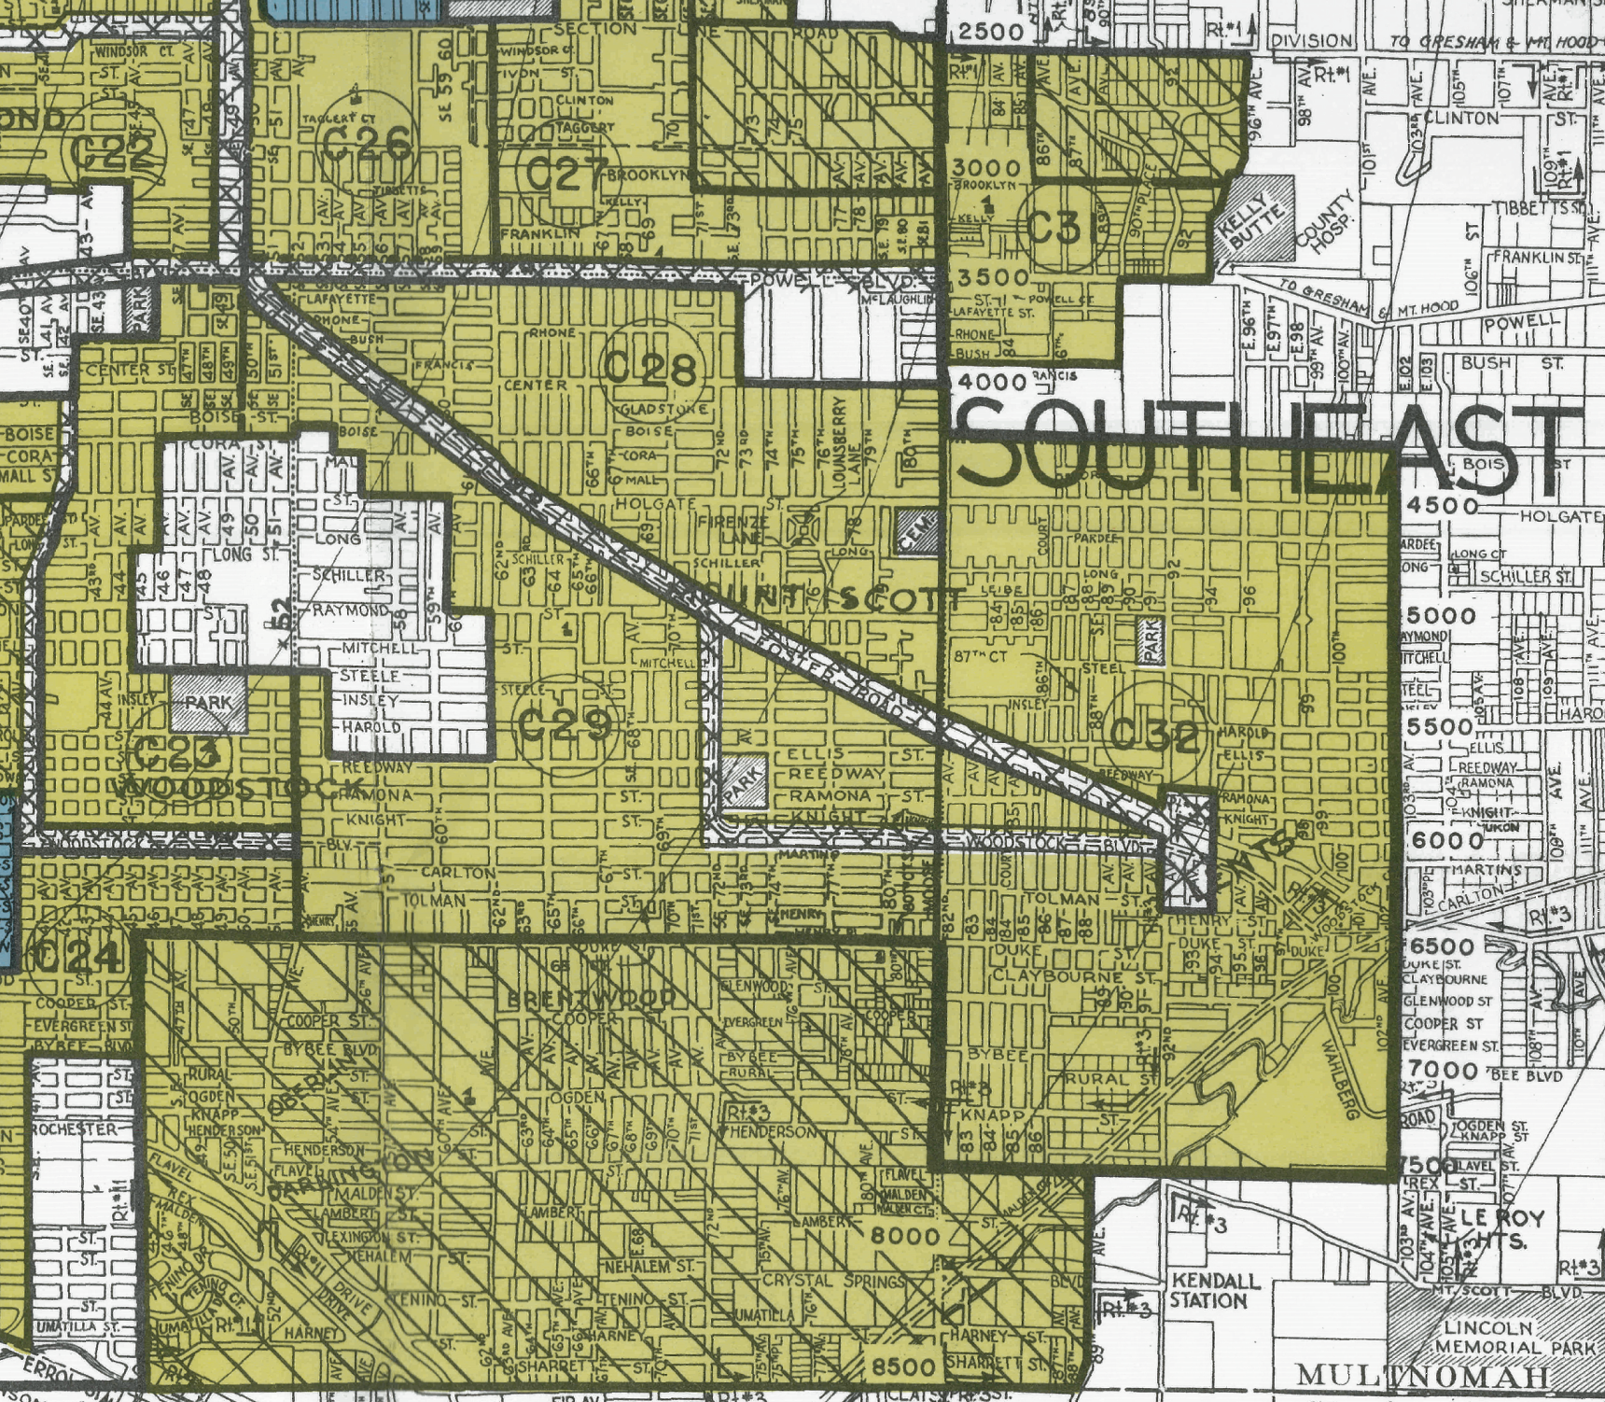
A study interested in finding if food deserts exist, discovered that in the US areas with a high concentration of low-income and/or African Americans had fewer grocery stores and more convenience stores compared to the “advantaged” areas.
During the New Deal era (1930s), the Powell-Gilbert neighborhood was zoned yellow and deemed a declining interest to mortgage lenders who were often more conservative about who they gave loans to. Black and other non-white people began to move into the area, giving it its “almost undesirable” zoning status.
Today, the average household income in this neighborhood is ~$38,000. Black and Brown people are the majority residing here.

Slide 10
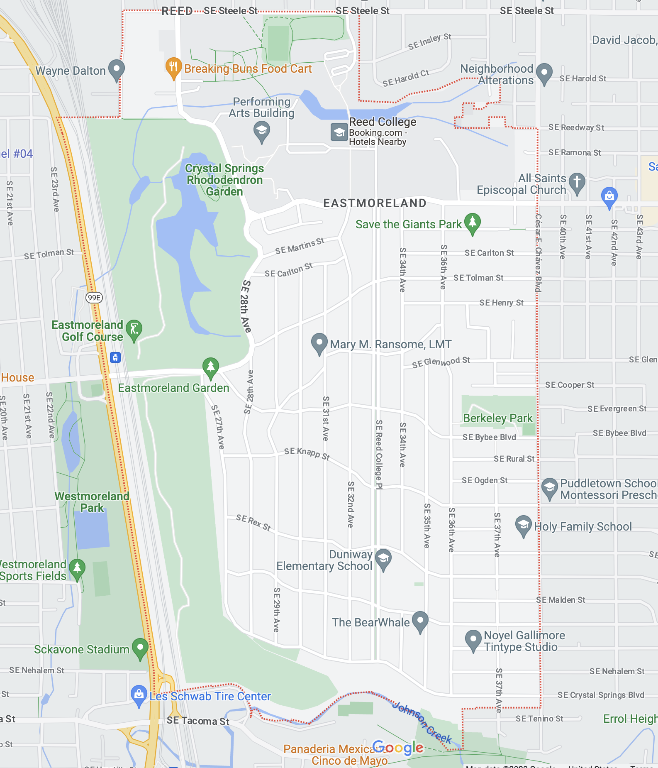
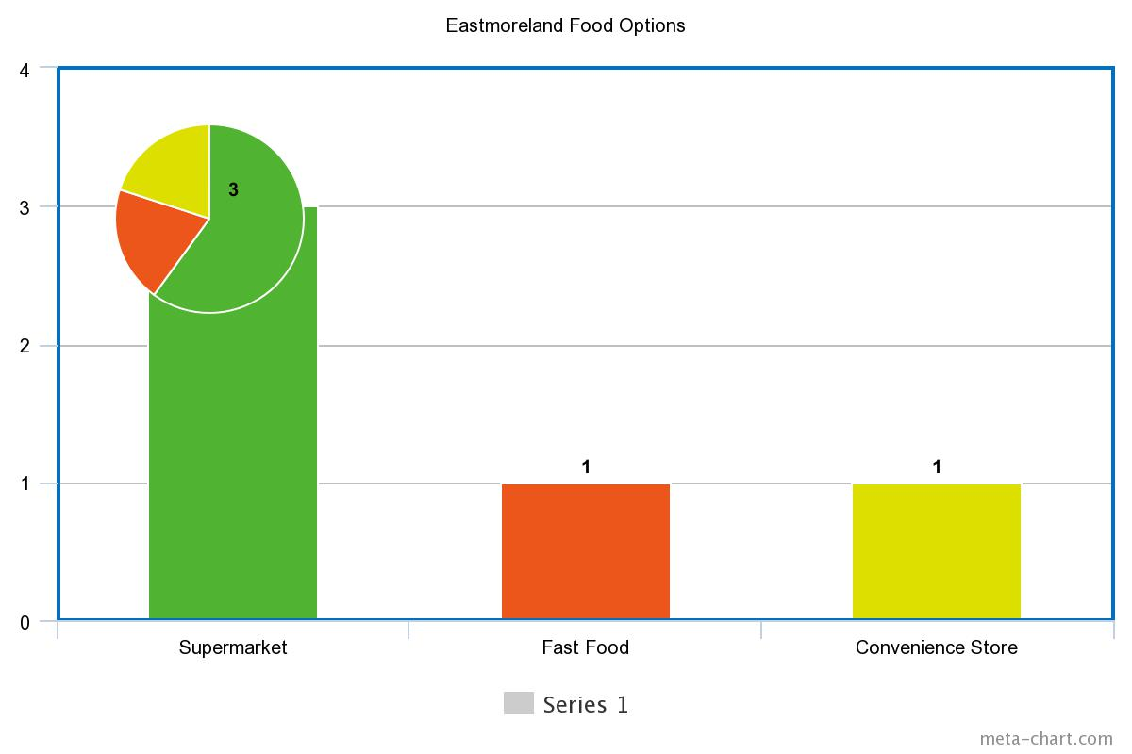
3 grocery stores: Trader Joes, New Seasons, and Safeway

Slide 11
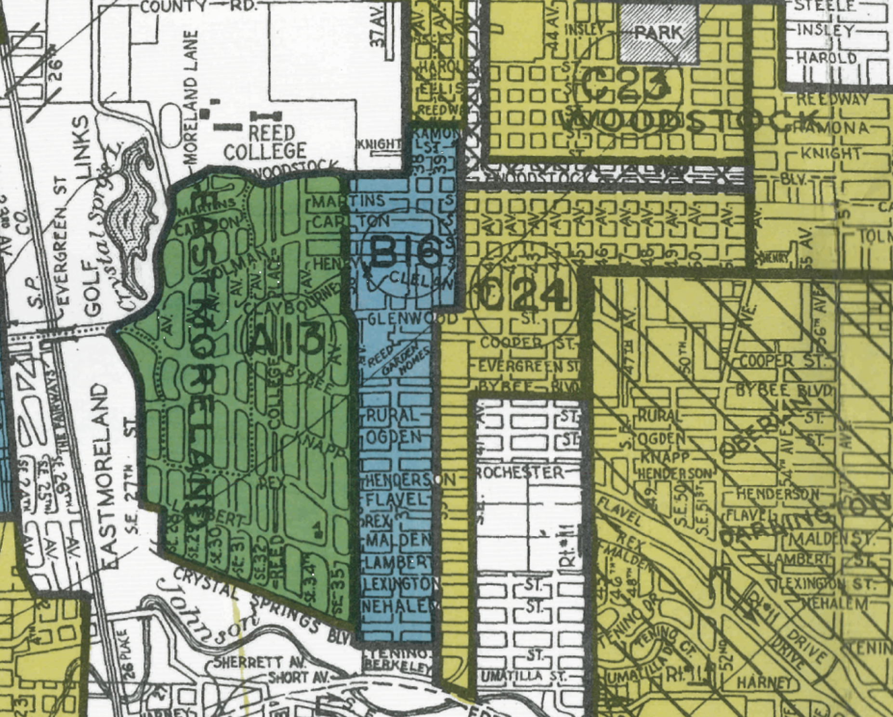
During the New Deal era, Eastmoreland was zoned as Green. This means the neighborhood is very desirable and should be invested in.
The average household incomein Eastmoreland is ~$116,000. The neighborhood is only made up of single family homes. White people are the majority residing here.

Slide 12
Why this matters
Many living in Oregon today do not know about the racist practices of the state.
Redlining has set off a ripple effect that many marganalized people today are impacted by. It is these people that experience the inequalities of environmental injustice and food scarcity.

